Slide 1
Clustered Form & Central Form
Central Form
Dominance
Proximity
One Form

Slide 2
University of Diyala
College of Engineering
Department of Architecture
1ST Stage
2018 – 2019
Lecture_ 10

Slide 3
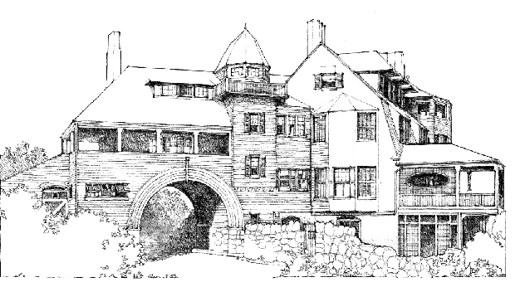

Slide 4
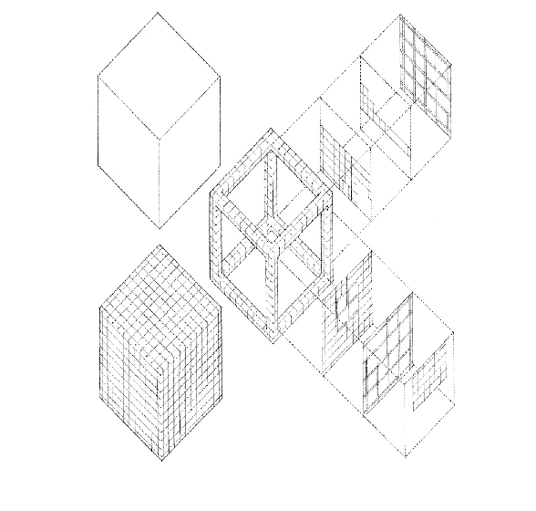
Grid Form

Slide 5
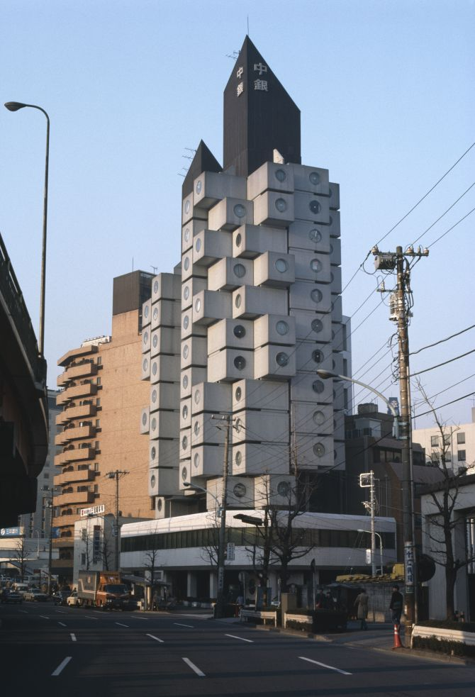
Grid Form

Slide 7
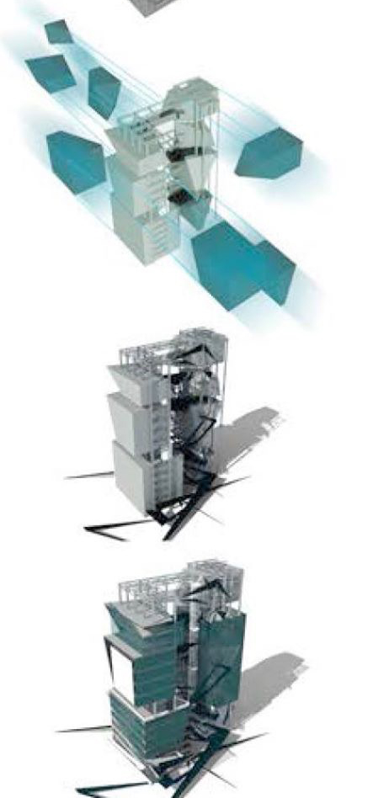

Slide 8
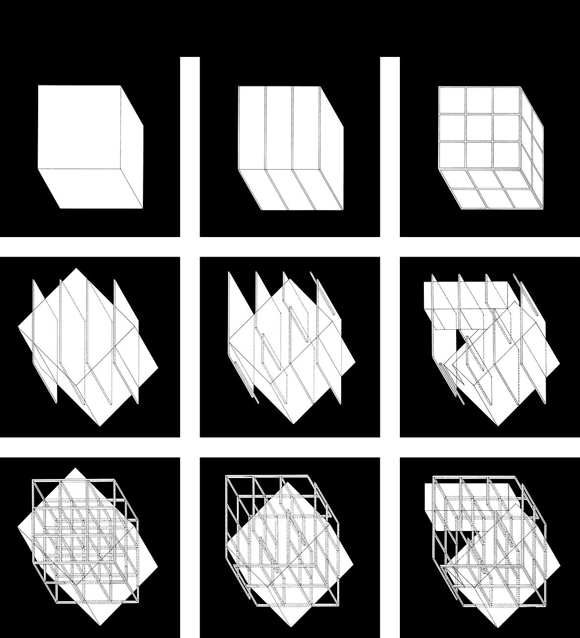
التشكيل بتداخل الشبكات

